Slide 1
APPLIED PHSICS
(SEAP-113)

Slide 2
Biasing of Diode

Slide 3
Biasing of Diode
In electronics, 'biasing' usually refers to a fixed DC voltage or current applied to a terminal of an electronic component such as a diode, in order to establish proper operating conditions for the component.
It is a crucial aspect of designing electronic circuits, especially in semiconductors like diodes, transistors.
Proper biasing ensures that the device operates in a stable and predictable manner.
Biasing a diode in electronics refers to the process of applying a specific voltage (or current) to the diode in order to control its electrical behavior and allow it to function in a desired way.
Two main types of diode biasing:
Forward Bias
Reverse Bias.

Slide 4
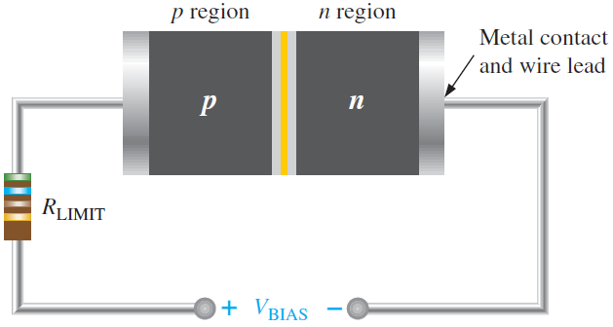
Forward Biasing
Biasing of diode is when it is connected with a voltage source
When n-type material is connected with -ive and p-type material is connected with +ive side of source, it is called forward biasing
V_{bias} should be greater than the barrier potential

Slide 5
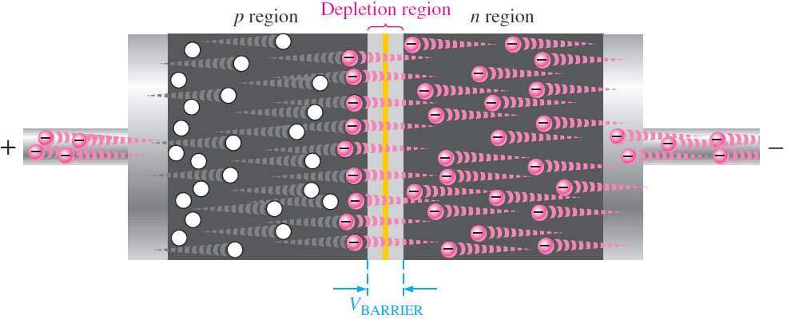
Forward Biasing (contd.)
when voltage is greater then the barrier potential, free electrons crosses the barrier potential and move into the p-type material
Electron current induced inside the diode

Slide 6
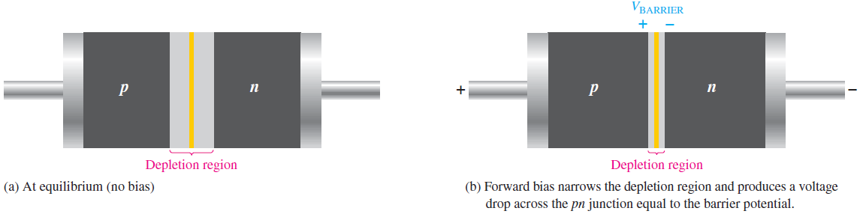
Forward Biasing (contd.)
More electron flow towards the depletion region, positive charge reduce and same is true for holes
This causes the depletion region to becomes narrow
Also the concept of energy hill

Slide 7
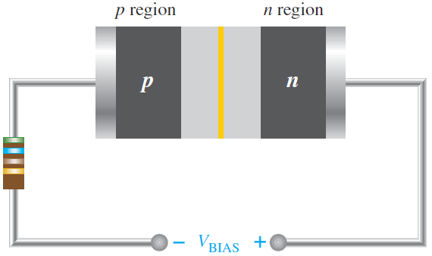
Reverse Biasing
Reverse biasing is the condition prevents the flow of current through diode.
When p-type is connected with -ive and n-type is connected with +ive end of source.
This arrangement increases the potential barrier at the junction of the diode.

Slide 8
Reverse Biasing (contd.)
When you apply a reverse bias to a diode, electrons in the N-type region are attracted towards the positive terminal of the source, creating a layer of positive ions. At the same time, holes in the P-type region are attracted towards the negative terminal, forming a layer of negative ions. These charged layers form what is called the depletion region. The width of depletion region also increased.
Due to increase in the width of depletion region, the potential barrier also increases, making it harder for electrons (majority carriers in N-type) and holes (majority carriers in P-type) to cross the junction.

Slide 9
Reverse Biasing (contd.)
In reverse biased diode, only a very small leakage current, known as reverse leakage current, flows through the diode. This current is due to the minority carriers that are thermally generated and able to cross the potential barrier.
The breakdown voltage of a diode, also known as the breakdown voltage rating, is the maximum reverse-bias voltage that a diode can withstand across its terminals without experiencing a significant increase in reverse current. When the reverse bias voltage exceeds this breakdown voltage, a phenomenon known as "diode breakdown" occurs, and the diode begins to conduct heavily in the reverse direction.

Slide 10
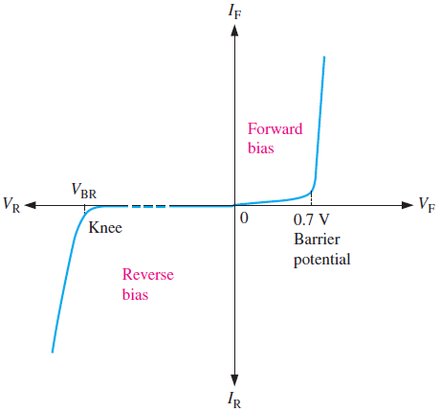
IV Characteristic Curve

Slide 11
Diode Models
Ideal Diode Model
It is the least accurate approximate model
The diode can be replace by a simple switch
When diode is forward bias, diode acts like a closed switch
When diode is reverse biased, diode acts like an open switch
The barrier potential, dynamic resistance of diode and reverse current are neglected
Only used for troubleshooting purpose, whether diode is working or not

Slide 12
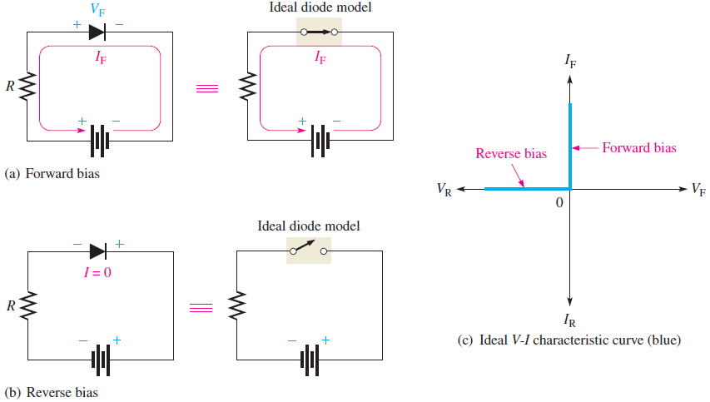
Diode Models (contd.)

Slide 13

Diode Models (contd.)
Since, barrier potential and dynamic resistance is neglected, the voltage across diode in forward bias is zero and current can be calculated as
$$I_{F}= \frac{V_{Bias}}{R_{Limit}}$$
Since, reverse current is neglected, means reverse current is zero and reverse voltage is equal to the bias voltage
$$I_{R}=0 and V_{R}= V_{Bias}$$

Slide 14
Diode Models (contd.)
Practical Diode Model:
In this approximation, the barrier potential is considered i.e. 0.7V for Si
In forward bias, a voltage source is considered with a closed switch
The +ive side of the source is at anode
Bias voltage should be greater then that voltage source in order to conduct a diode
In reverse bias, voltage source will not effect the circuit as diode acts as an open switch

Slide 15
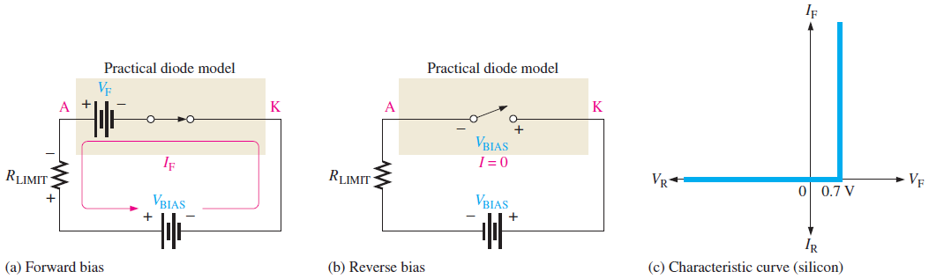
Diode Models (contd.)

Slide 16

Diode Models (contd.)
As diode has a voltage drop of 0.7V so
$$V_{F}=0.7V$$
The current through the diode can be calculated by KCL, hence
$$I_{F}= \frac{V_{Bias}−V_{F}}{R_{Limit}}$$
In reverse bias, reverse current is zero and reverse voltage is equal to the bias voltage
$$I_{R}=0 and V_{R}= V_{Bias}$$
This approximation is useful when dealing with the low voltage calculations and designing basic diode circuits

Slide 17
Diode Models (contd.)
Complete Diode Model:
It is the most accurate diode approximation
It includes the barrier potential, a small forward internal dynamic resistance and a large internal reverse resistance
Reverse resistance is taken because it provides a path for reverse current which is included in the approximation

Slide 18
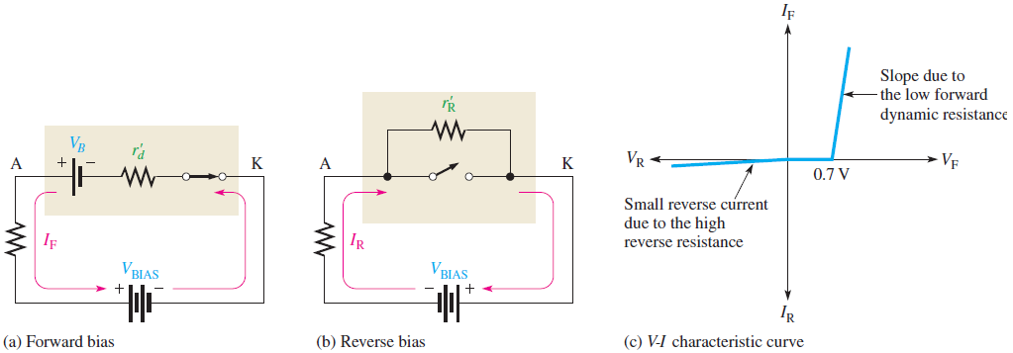
Diode Models (contd.)

Slide 19

Diode Models (contd.)
The values for the forward voltage and current can be calculated as:
$$V_{F}=0.7V+{I_{F}r}_{d}$$
and
$$I_{F}=\frac{V_{Bias}−0.7V}{R_{Limit}+r_{d}}$$

Slide 20
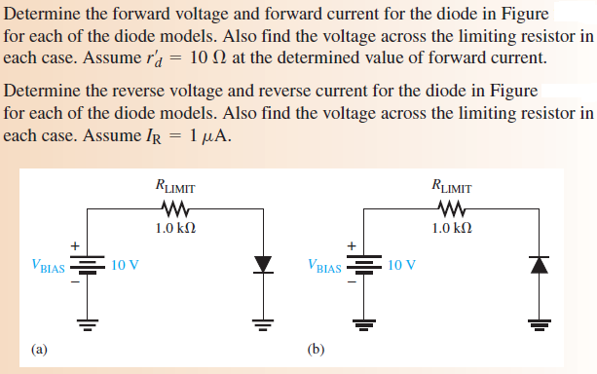
Diode Models (contd.)

Slide 21
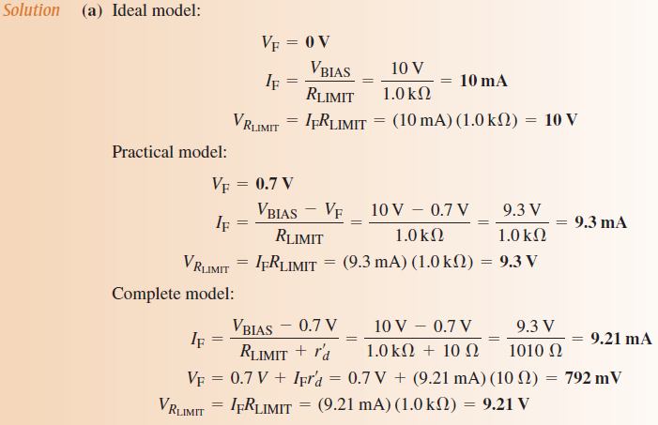
Diode Models (contd.)

Slide 22
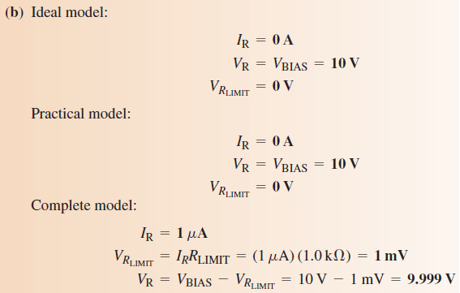
Diode Models (contd.)

